Slide 1
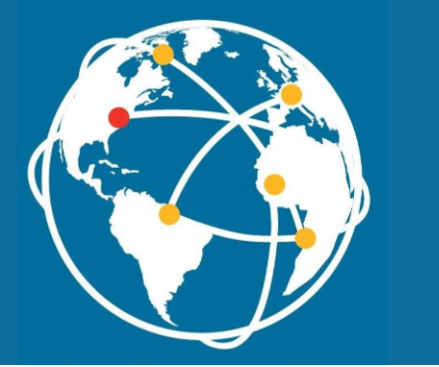
UMB institutional learning outcomes:
Interprofessional Education
Community Engagement
Global Health → GLOBAL ENGAGEMENT AND EDUCATION
Leadership
Cultural Competency (Diversity, Equity, and Inclusion)
Ethics and Integrity

Slide 2
Why did UMB select Global Engagement and Education as an ILO?

Slide 3
National movement to incorporate “global learning” into higher education
Undergraduate first but now: graduate and professional education
Led by American Association of Colleges and Universities
Why global learning?
We need to develop professionals who are ready to engage across different cultural, political, and regulatory environments to resolve global challenges equitably.
Their world:
Global health and climate challenges with no borders
Global networks and collaborations drive scientific discoveries and social awareness.
Global dynamics influence our economies and policies and shape who we meet in our communities as neighbors and co-workers.

Slide 4
Changing demographics
US Census Bureau projects that almost 20% of the US population will be foreign-born by 2060.
US Census data on MD population
In 1990, 6.6% of Maryland residents were foreign-born
In 2019, 15.4% of Maryland residents were foreign-born.
.

Slide 5
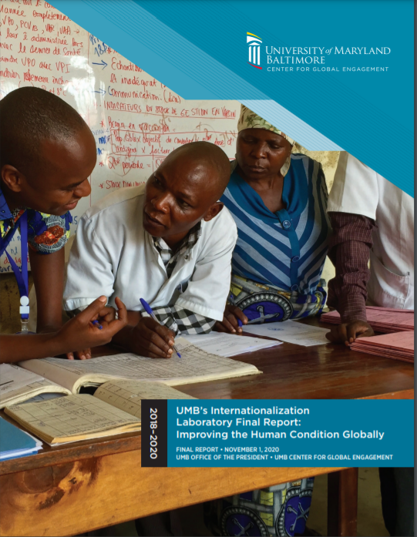
Movement toward global engagement and education at UMB
UMB Internationalization Report 2018-2020
Recommendation #4: GLOBAL EDUCATION FOR ALL STUDENTS: All students should have the opportunity to engage in global learning during their time at UMB. Develop new curricular and co-curricular globally focused courses and clinics for students. Global concepts should be woven through the required and elective curriculum.
UMB Strategic Plan
Theme: Global Engagement and Education
Outcome #1: All students have the opportunity to engage in global learning during their time at UMB.

Slide 6
Does this mean every student getting on a plane?
No - global learning is a combination of local, regional, national, and international experiences through which students develop global awareness, meaningful engage across cultures, and learn how to pursue global action.
How?
Global curriculum (e.g., globalized courses and clinics inc. COIL; education abroad and away; research with global partners or on global issues)
Global co-curricular experiences (e.g., community-engaged service learning; PSLI; internships; global living and learning community; campus programs and clubs; and global learning events and activities)
Notes:
Immigrant and refugee clinics, teach with global framework (social determinants of health), apply human rights framework to police brutality

Slide 7
Global Learning Goals
AACU Global Learning Goals
Global Self-Awareness
Perspective Taking
Cultural Diversity
Personal and Social Responsibility
Understanding Global Systems
Applying Knowledge to Contemporary Global Contexts
UC Davis Global Learning Goals
Global Awareness
Global Diversity
Global Action

Slide 8
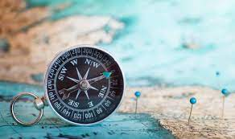
Learning Goals to Learning Outcomes

Slide 9
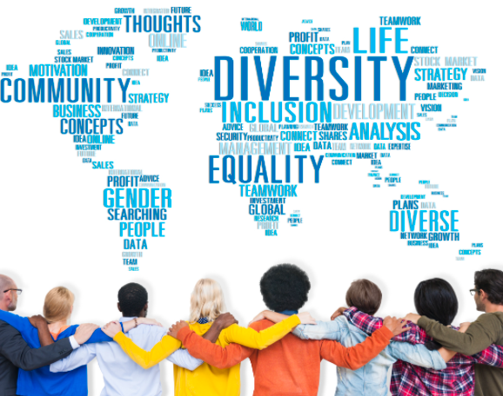
Global Diversity
UCDavis Learning Outcome:
Examine multiple and intersecting dimensions of cultural diversity (including, but not limited to, race, ethnicity, gender, nationality, religion, language, and class), discovering our own and others’ cultures and histories, including experiences of privilege and oppression.
UMB ILO = *can overlap with cultural competence ILO if nationality included.* Most schools will already have something like this.

Slide 10
Global Action
UCDavis Learning Outcome: Apply knowledge, skills, and abilities to contribute to society at multiple levels - locally, regionally, nationally, and globally - demonstrating cultural humility and ethical, informed, and responsible actions.
Proposed UMB ILO: Understand the role and responsibility of (lawyers, pharmacists, physicians, etc.) in achieving justice for individuals and communities locally, regionally, nationally, and globally.
*could overlap with community engagement or leadership ILOs*
UMB Example:
UM Carey Law Learning Outcome
By the time of graduation each student will demonstrate the ability to . . .
Understand the role and responsibility of laws, lawyers, and legal systems in achieving justice for society and individuals, including those who lack access to effective legal representation.

Slide 11
Global Awareness
UCDavis Learning Outcome: Evaluate complex and overlapping systems in a global context, including natural systems (e.g. environmental, biological, chemical, physical) and human systems (e.g. cultural, economic, political, legal, health, social, and technological).
Possible UMB ILO: Compare and contrast two or more national frameworks or systems relevant to student’s future professional practice.
Possible UMB ILO: Apply an international framework to evaluate a US system relevant to student’s future professional practice.
UMB Example:
UMSSW/Council on Social Work Education 2015 Accreditation Standards: Competency 3: Advance Human Rights and Social, Economic, and Environmental Justice
Social workers understand the global interconnections of oppression and human rights violations, and are knowledgeable about theories of human need and social justice and strategies to promote social and economic justice and human rights.

Slide 12
Next Steps
Look at accreditation standards, professional and ethical codes, school-specific goals and outcomes for specific global learning outcomes (hint: there won’t be much there) but also related concepts:
Cultural competence
Diversity, equity, and inclusion
Human Rights
Social determinants of health
Social justice
Comparative systems
Global challenges
Community engagement
Schools are already engaged in global learning – determine what’s already happening and create new curricular and co-curricular opportunities
Explore creating a “Global Scholar” designation on UMB diplomas based on approved rubric of global learning.
Stakeholders: IZN working group, Center for Global Engagement Advisory Group

